Slide 1
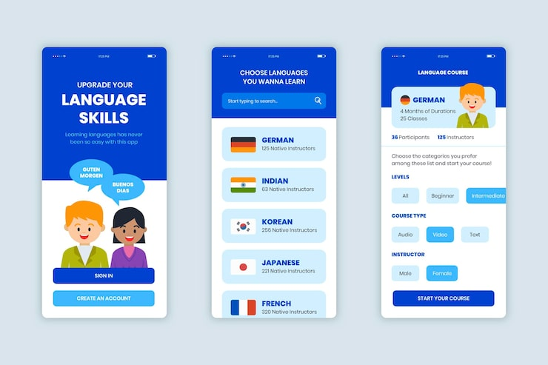
LinguaNews: Real-World Language Learning Through Authentic News

Slide 2
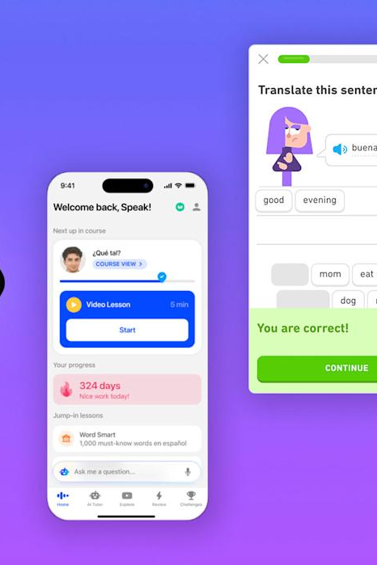
Welcome to LinguaNews
LinguaNews is a revolutionary language learning platform that immerses users in authentic news content from around the world. By seamlessly integrating vocabulary support, difficulty-based filtering, and personalized tracking, LinguaNews bridges the gap between textbook exercises and the realities of navigating a new language.

Slide 3






Onboarding: Select Your Language
Language Grid
Choose from Spanish, French, German, Italian
Beginner-Friendly
Suitable for all proficiency levels
Personalized Experience
Set your target language for customized content
Skip for Now
Option to select language later

Slide 4






Browsing the News Feed
Difficulty Filters
Select beginner, intermediate, or advanced
Topic Filters
Browse articles by technology, business, sports, and more
Personalized Recommendations
Tailored to user's language level and interests
Detailed Article Cards
Metadata, difficulty, and reading time at a glance

Slide 5




In-Context Vocabulary Lookup
Click Any Word
Instantly view translation and definition
Difficulty Indicator
See word's CEFR level at a glance
Contextual Examples
Learn new words in real-world usage
No Context Switching
Stay focused on the article content

Slide 6



Personalized Vocabulary Tracking
Saved Words
LinguaNews tracks vocabulary words you look up
Vocabulary List
Review and practice your growing word bank
Difficulty Levels
Words are categorized by beginner, intermediate, advanced
Progress Tracking
Monitor your vocabulary growth over time

Slide 7




Comprehensive System Architecture
Presentation Layer
Business Logic Layer
Data Access Layer
External Data Sources
The Presentation Layer is responsible for the user-facing UI and interaction. It is built using ASP.NET Core Razor Pages and includes components for the Article Feed, Article Reader, Vocabulary List, and User Settings. This layer communicates with the Business Logic Layer to fetch and display data.
The Business Logic Layer houses the core application services, including the Article Service, Vocabulary Service, and User Service. These services handle tasks such as fetching news articles from NewsAPI, normalizing the article data, calculating difficulty estimates, and managing user vocabulary. The Business Logic Layer sits between the Presentation Layer and the Data Access Layer.
The Data Access Layer is responsible for communicating with external data sources and the internal database. It includes an API Manager to handle HTTP client interactions, a Cache Manager to reduce API calls, and a Database Repository for storage. This layer abstracts the complexities of data retrieval and caching, allowing the Business Logic Layer to focus on application-specific logic.
The LinguaNews application integrates with four key external data sources: NewsAPI (primary news content), DeepL (translation and definitions), CEFR Database (word difficulty ratings), and 1000 Most Common Words API (word frequency data).

Slide 8


User Journey: From Onboarding to Mastery
Browse Articles
Review Vocab
Filters content by difficulty and topic
Practices saved words through spaced repetition
Search Interests
Mastery
Looks for articles on specific subjects
Select Language
Chooses target language from options
Save to Vocab
New User
Look Up Word
Adds new words to personal vocabulary list
Visits LinguaNews for the first time
Clicks on unknown vocabulary for translation
Read Article
Engages with authentic news content
Onboard

Slide 9
Key Features Showcase
📰 Authentic News Articles
🎯 Smart Difficulty Ranking
Learn from real news content that native speakers consume. LinguaNews provides access to articles from leading publications like El País, BBC Mundo, and Le Monde, updated daily with current events across multiple languages.
Articles are automatically categorized as Beginner, Intermediate, or Advanced based on CEFR-aligned word analysis. This ensures you can find content that matches your current proficiency, gradually progressing to more challenging material as your skills improve.
💡 Instant Vocabulary Lookup
📚 Personal Vocabulary Tracker
When reading an article, simply click on any unfamiliar word to instantly view its translation, definition, part of speech, and example usage. This in-context vocabulary support reduces the need to constantly interrupt your reading to look up terms.
Save words you want to learn to your personalized vocabulary list. The application tracks your progress, categorizing words by difficulty level, to help you review and reinforce your growing lexicon over time.

Slide 10
Results and Impact
Percentage increase in vocabulary retention and language proficiency metrics compared to traditional learning apps
92%
78%
35%
Vocabulary Retention
Reading Comprehension
User Growth

Slide 11

LinguaNews empowers language learners to thrive in a multilingual world, seamlessly bridging the gap between textbook exercises and real-world communication. By harnessing the power of authentic news content, intelligent vocabulary support, and personalized tracking, the platform unlocks new levels of language proficiency, revolutionizing the way we approach language education.

